Slide 1

Minor Project Report on Sign Language Recognition
Presented To: -
Presented By: -
Dr. Dheerendra Singh
Priyadarshini
LCO17373
CSE 7TH SEM

Slide 2
Outline
Introduction
Motivation
Problem statement
Practical application
Features
Technologies used
Working
Conclusion & future scope

Slide 3
Introduction
This project aims to identify Sign Language. The problem I am investigating is the recognition of sign language through unsupervised learning.
I am developing a sign language recognition system using a small vocabulary and database.
Deaf and mute people rely on sign language interpreters for communication. However, finding experienced and trained translators in their daily affairs of life is a daunting task. Therefore, the computer-to-computer system will be a reliable and consistent solution for such people

Slide 4
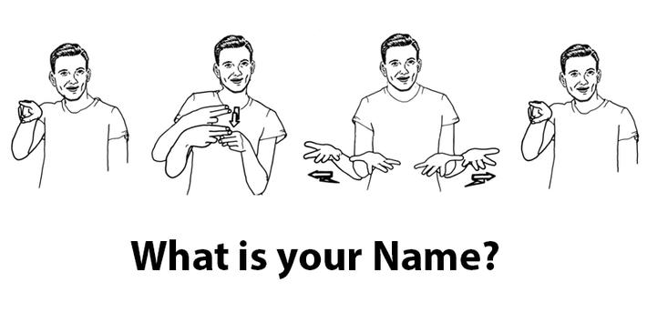
Motivation
A person with speaking disorders face major problems of expressing their emotions as freely in this world.
“Not able to utilize” some of the new technologies.

Slide 5
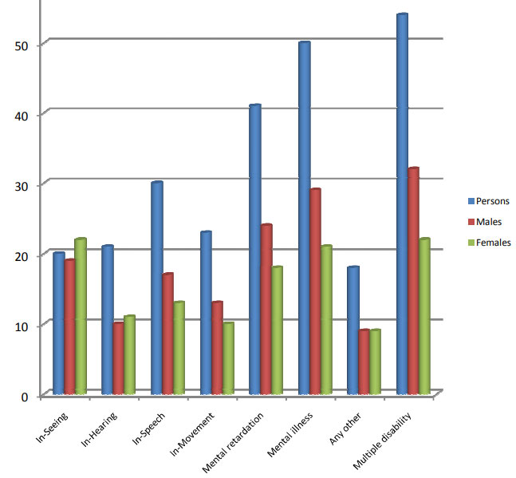
Statistics of Disabled Population in India:

Slide 6
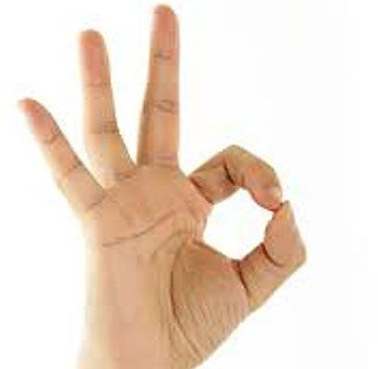
Problem Statement
Given a hand gesture, implementing such an application which detects pre- defined Sign language in a real time through hand gestures and providing facility for the user to be able to store the result of the character detected in a txt file, also allowing such users to build their customized gesture so that the problems faced by persons who aren’t able to talk vocally can be accommodated with technological assistance and the barrier of expressing can be overshadowed.

Slide 7
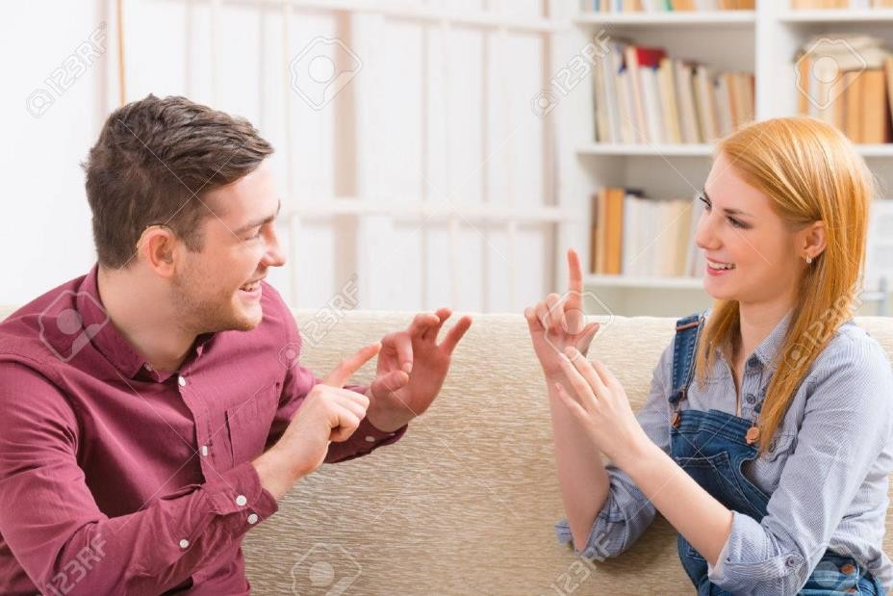
Practical application
Serves the person who wants to learn and talk in sign languages
A user need not be a literate person
Very essential for deaf-mute people, to communicate both with normal people and with themselves
Simply detects the gesture and displays
appropriate alphabets

Slide 8
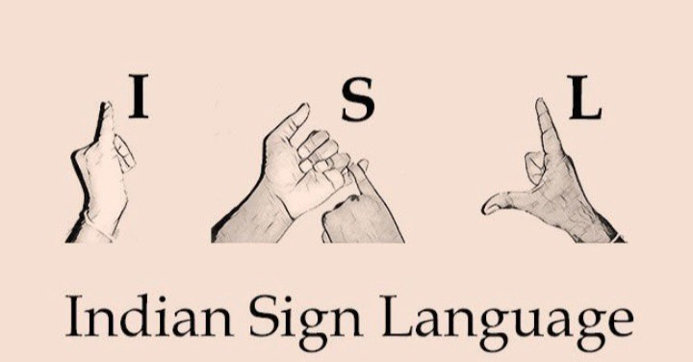
Features of this application
Real time detection based on gesture made by user.
Customized gesture generation.
assistance mechanisms concerning to the illiterate people.
An Sign Language is one of the way to communicate with deaf people.

Slide 9




Technologies Used
Python (3.7.4)
IDE (Jupyter)
Numpy (version 1.16.5)
cv2 (openCV) (version 3.4.2)
Keras (version 2.3.1)
Tensorflow (as keras uses tensorflow in backend and for image preprocessing) (version 2.0.0)

Slide 10
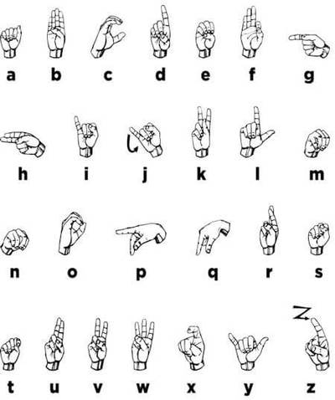
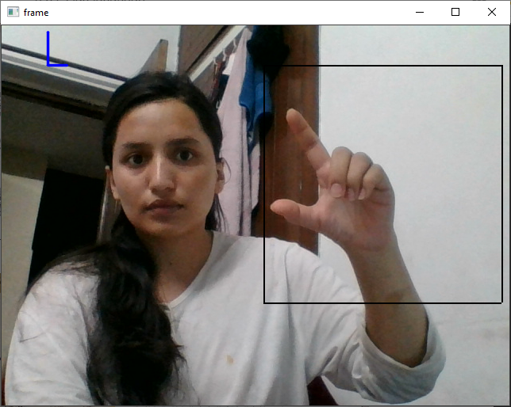
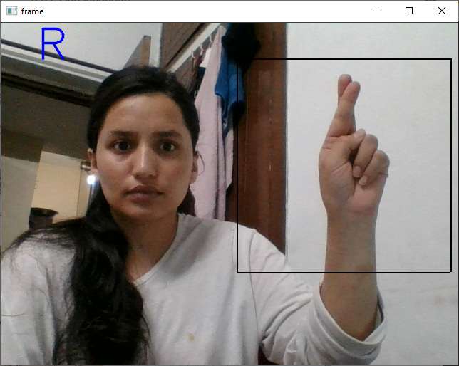
Working
Sign Language A to Z alphabet symbols

Slide 11
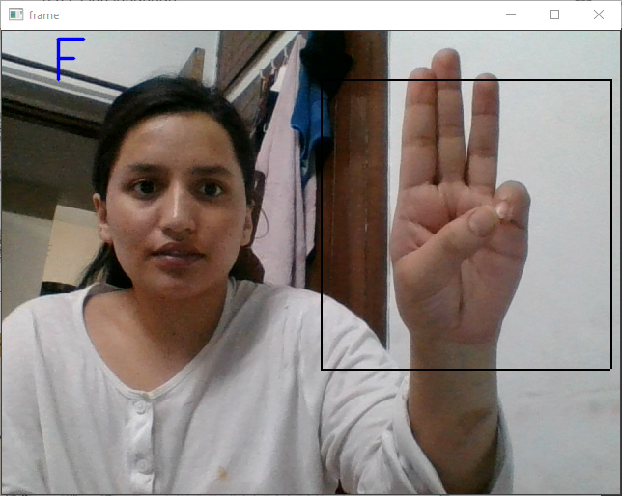
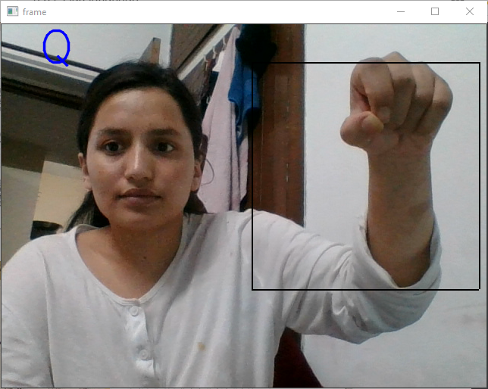
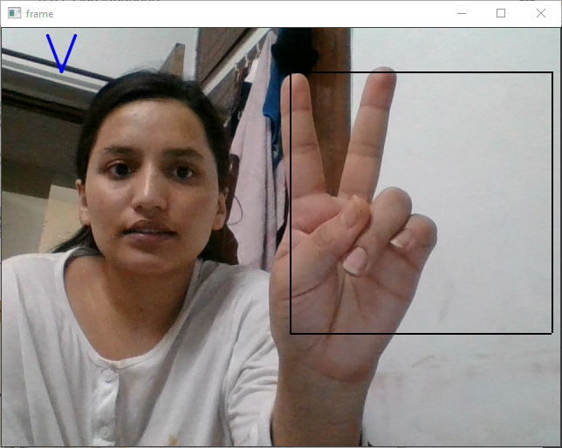
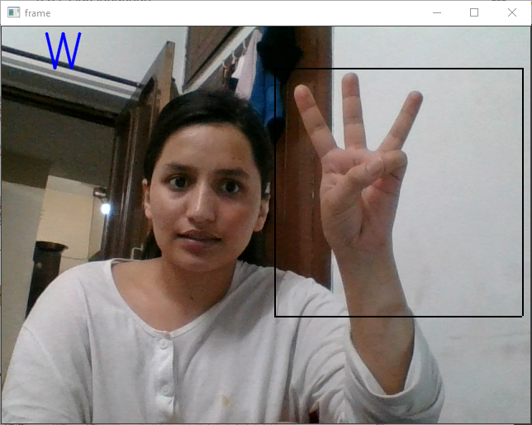
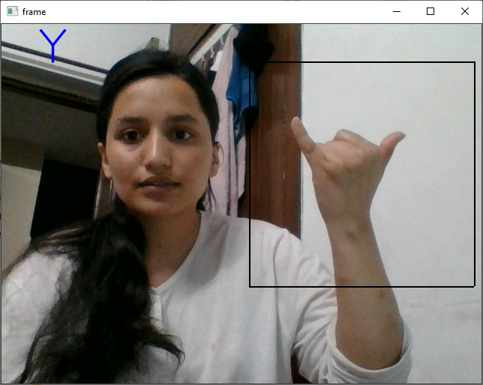

Slide 12
Conclusion
Overshadowing some of the major problems faced by the persons having speech
disorders.
They can quickly learn what alphabet is assigned to which gesture with this
application.

Slide 13
Future Scope
Integration to search engines and texting application.
Detection of motion video sequence with TTS assistance.
Add-On to this can provide sentence formation in future.

Slide 14
